Slide 1
Introduction to eSight 21.0 Server Device Management

Slide 2
Upon completion of this course, you will be able to:
Understand features of eSight server management.
Understand deployment of eSight server management.
Understand routine O&M of eSight server management.

Slide 3
1
Features
2
Deployment
3
Routine O&M

Slide 4


Features of eSight Server
Resource monitoring
Feature overview
Resource addition: Both Huawei-developed and third-party servers can be added.
Alarm management
Resource addition
Resource monitoring: Basic server information (including the model, status, product serial number, and power), system information (including the iBMA information, OS information, and domain name), and component information (including the mainboard, CPU, GPU, memory, hard disk, power supply, fan, NIC, PCIe card, RAID controller card, mezzanine card, network port, and sensor) can be monitored.
Resource management
Alarm monitoring: Alarms of both Huawei-developed and third-party servers can be monitored.
Performance monitoring: Both real-time and historical performance, such as the server CPU usage, memory usage, and disk usage, can be monitored.
Performance management
Remote redirection: Redirection to the iBMC management page or remote console of a server is supported.
Remote redirection
The resources include servers, components, alarms, and performance data.
The devices include rack, blade, high-density, heterogeneous computing, KunLun, and third-party servers.
For details about the server models and indicators supported by the features, see eSight 21.0 Server Management Feature List.

Slide 5
1
Features
2
Deployment
3
Routine O&M

Slide 6
Deployment Overview
Subnet planning
Device addition
Monitoring configuration
Add the servers to be managed to eSight through Redfish and SNMP, and adjust the topology layout based on network positions.
(Optional) Subnet planning
Device addition
(Optional) Monitoring configuration
By default, performance collection tasks, large screens, and report data are preset and usable-upon-unpacking. You can adjust them as required.
Categorize servers by subnet to facilitate hierarchical monitoring.

Slide 7
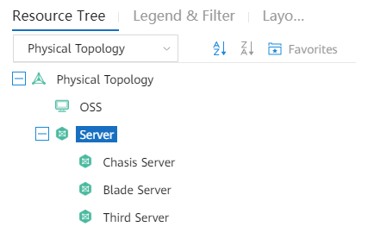
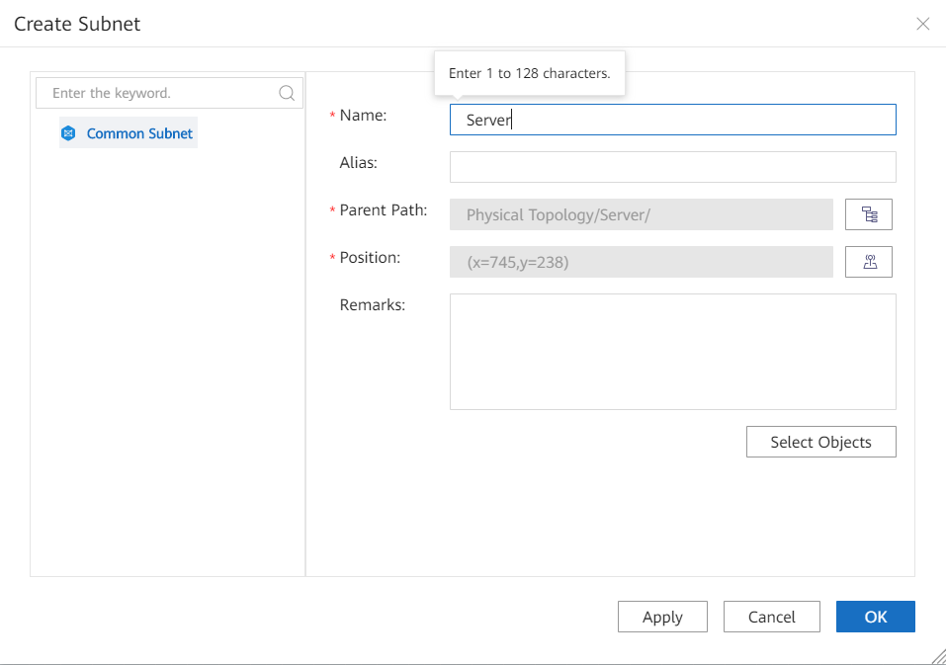
Subnet Planning
Subnet: A large network is divided into several subnets based on a specific rule (for example, by service type), which facilitates network management. Server subnets are generally created to classify servers.
A server can belong to only one subnet.

Slide 8
Resource Addition
Servers can be added to eSight using the following methods:
Add one by one: Add a server based on a specified IP address.
Automatic discovery: Add all servers in a specified network segment.
Batch import: Devices are discovered in batches by importing a file. (The iBMC IP addresses of the devices have been configured.)
SSDP-based discovery: Devices are discovered in batches by importing a file. Set the iBMC IP addresses of the devices, and add the devices to eSight.
For details about server models, see eSight 21.0 Server Management Device List.
Server Type |  | Device Addition Modes |  |  |  | Access Protocol
 |  | Add One by One | Automatic Discovery | Batch Import | SSDP-based Discovery
Huawei-developed server | V2 | Supported | Not supported | Supported | Supported | SNMP
 | V3/V5/V6 | Supported (Redfish) | Supported (Redfish) | Supported | Supported | Redfish
Heterogeneous computing server (Atlas) |  | Supported | Supported (Redfish) | Supported | Supported | Redfish
OEM white-box server |  | Supported | Supported (Redfish) | Supported | Supported | Redfish
Third-party server |  | Supported | Supported (Redfish) | Supported | Not supported | SNMP/Redfish

Slide 9
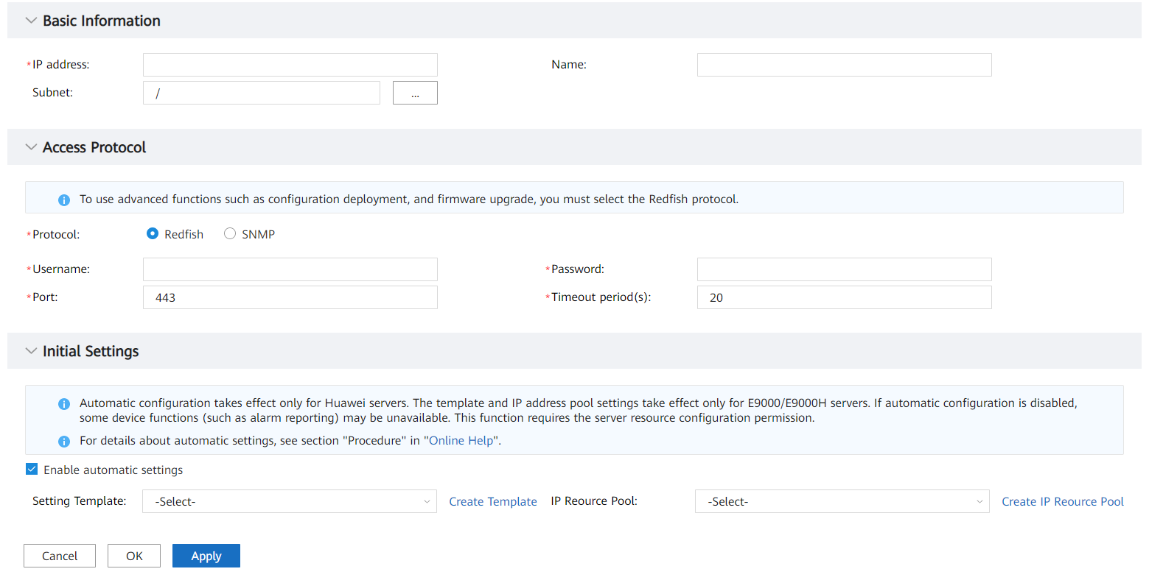
Resource Addition - Add One by One
Adding devices based on Redfish: Huawei-developed servers can be discovered by specifying the IP address of a single server.
Enter the device IP address, for example, 10.10.10.2.
The default value is Model-IP address. Use the default value.
Select a subnet.
Select the discovery protocol supported by the device.
Select an auxiliary protocol. Some functions require a specified protocol.

Slide 10
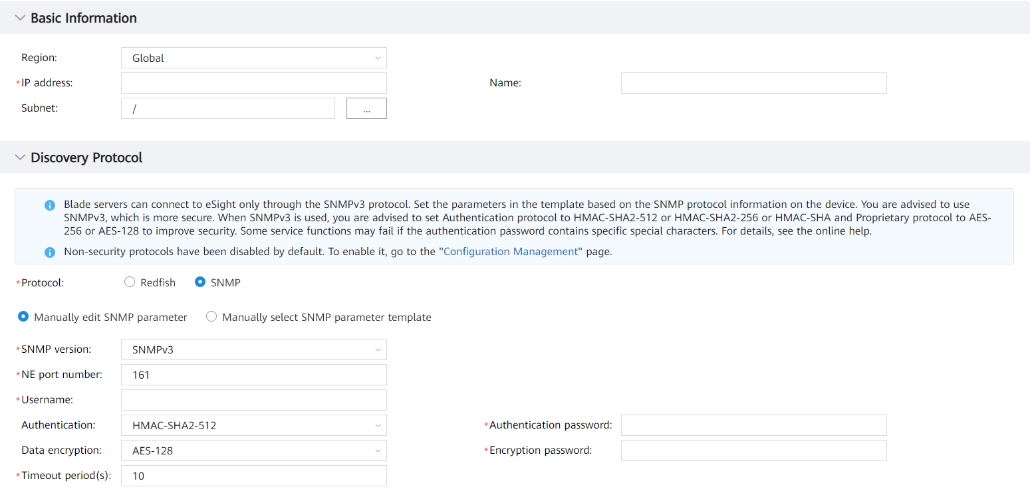
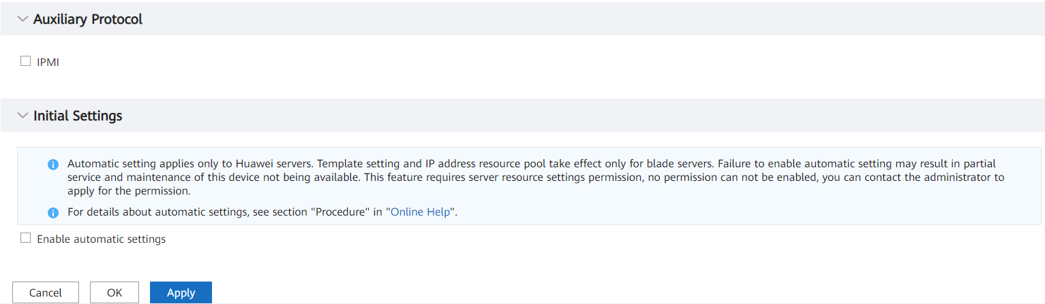
Resource Addition - Add One by One
Adding devices based on SNMP: Early Huawei devices that support only SNMP can be added to eSight based on SNMP.
Enter the device IP address, for example, 10.10.10.2.
The default value is Model-IP address. Use the default value.
Select a subnet.
Select the discovery protocol supported by the device.
Select an auxiliary protocol. Some functions require a specified protocol.

Slide 11
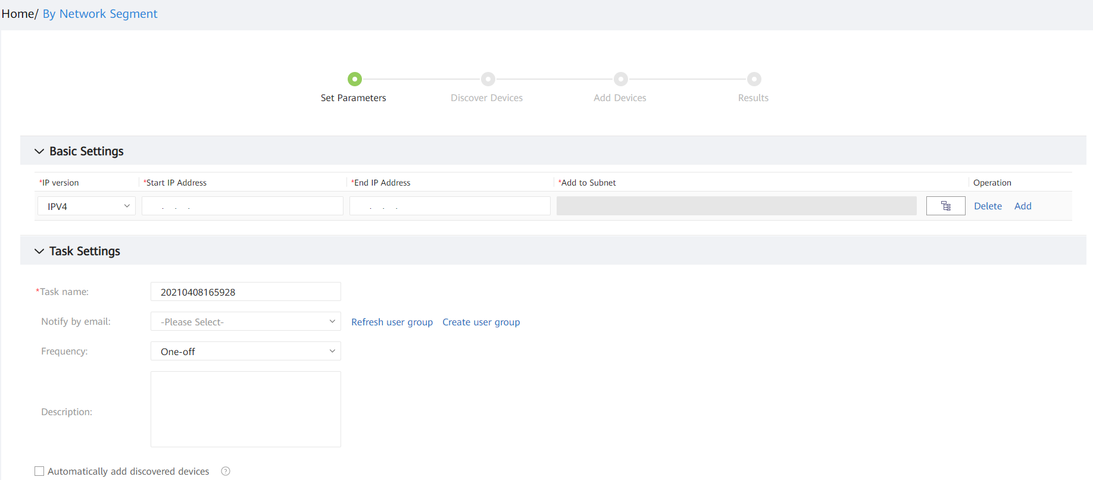
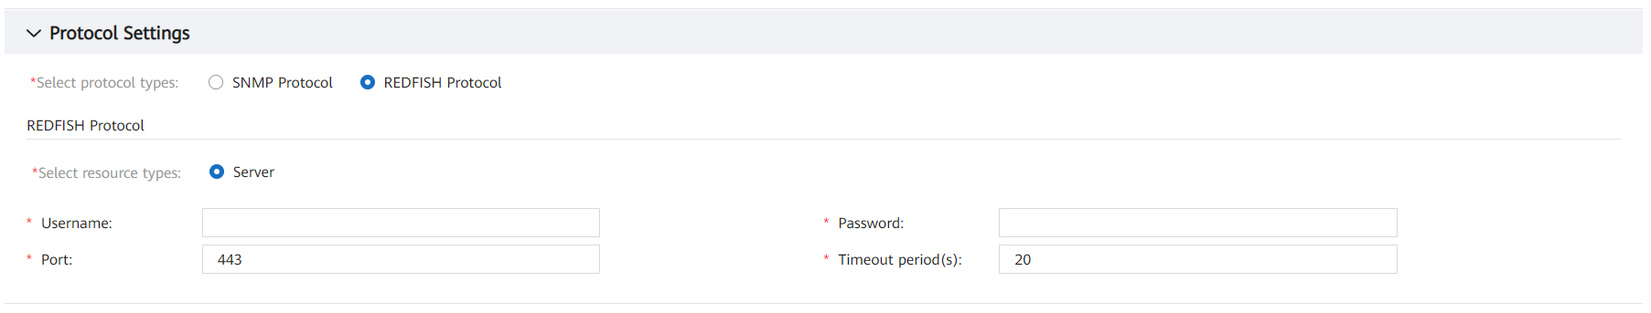
Resource Addition - Automatic Discovery
Huawei-developed and third-party servers can be automatically discovered based on a specified IP segment.
Tasks can be performed based on the specified policy.
Authentication parameters of the specified network segment must be the same as those of the discovery module.
Specify a network segment for discovery, for example, 10.2.2.2.
Select a subnet.
Select a discovery protocol. Redfish is recommended for servers.

Slide 12
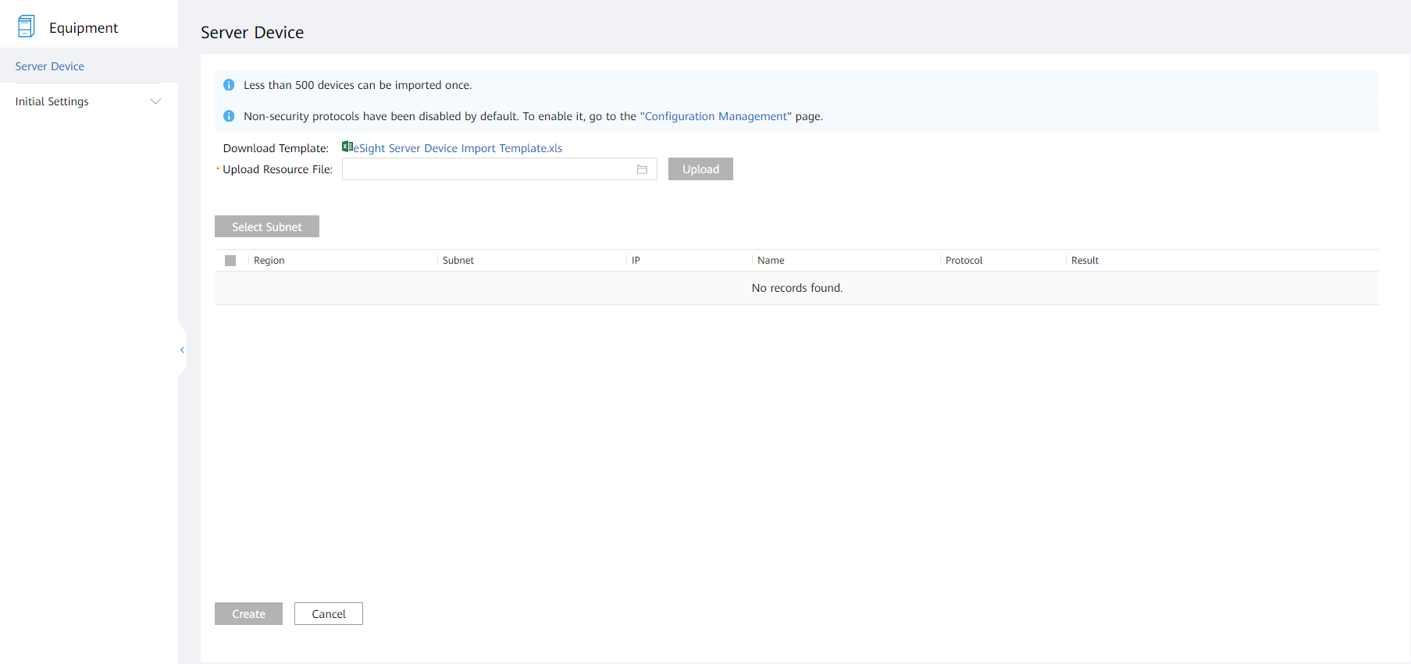
Resource Addition - Batch Import
Both Huawei-developed and third-party servers can be imported in batches, improving device discovery efficiency.
Download the template.
Upload the file that contains device information.
Add servers to eSight.

Slide 13
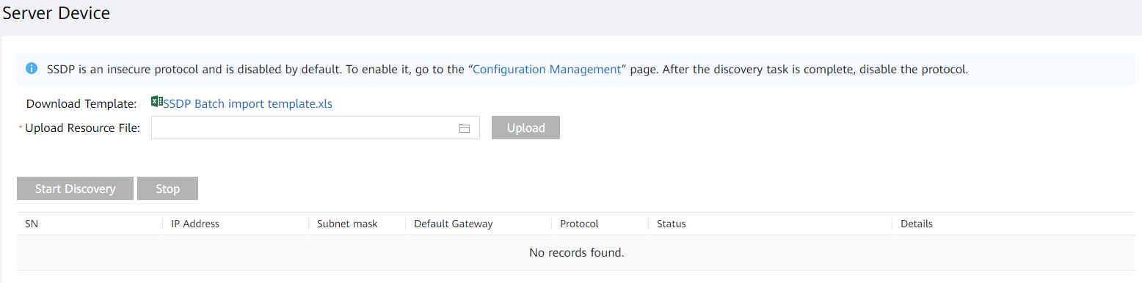
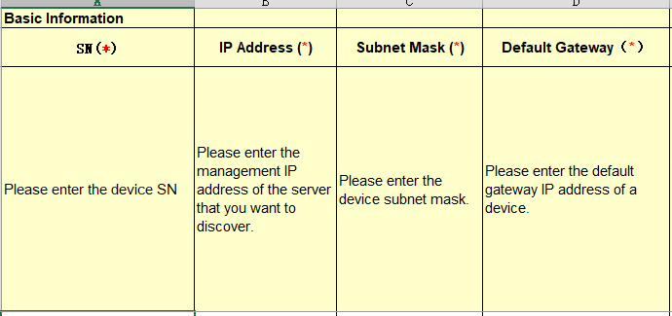
Resource Addition - Batch Import
Huawei-developed servers can be imported. This function is mainly used in deployment scenarios. The iBMC IP addresses are automatically set based on the mapping between SNs and IP addresses, and servers are added to eSight.
Download the template.
Upload the file that contains device information.

Slide 14
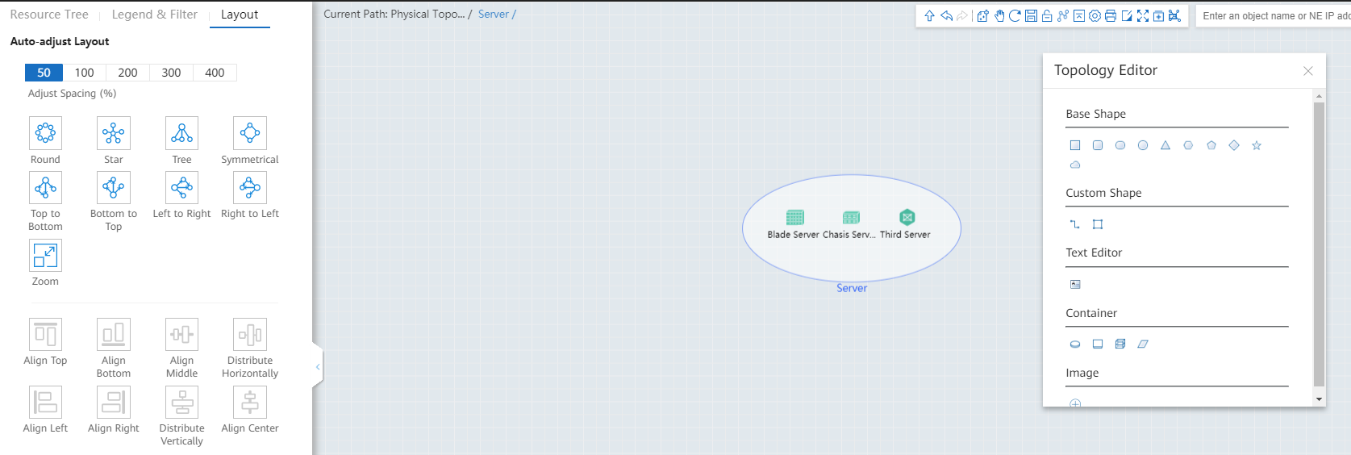
Monitoring Configuration - Topology Layout
Set the automatic layout style.
Manually add shapes to make the layout clearer.
Add shapes.

Slide 15
1
Features
2
Deployment
3
Routine O&M

Slide 16
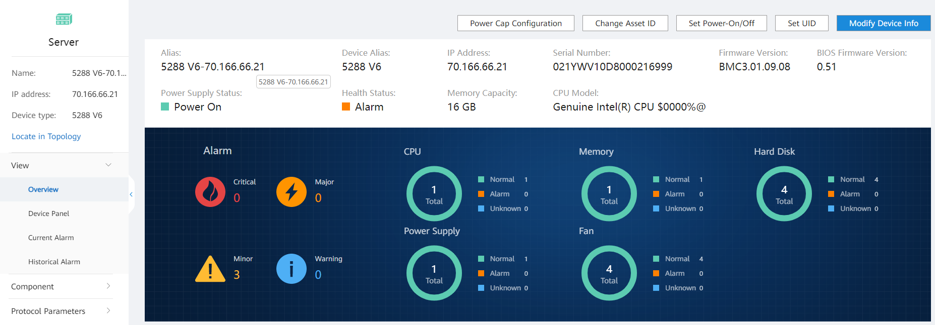
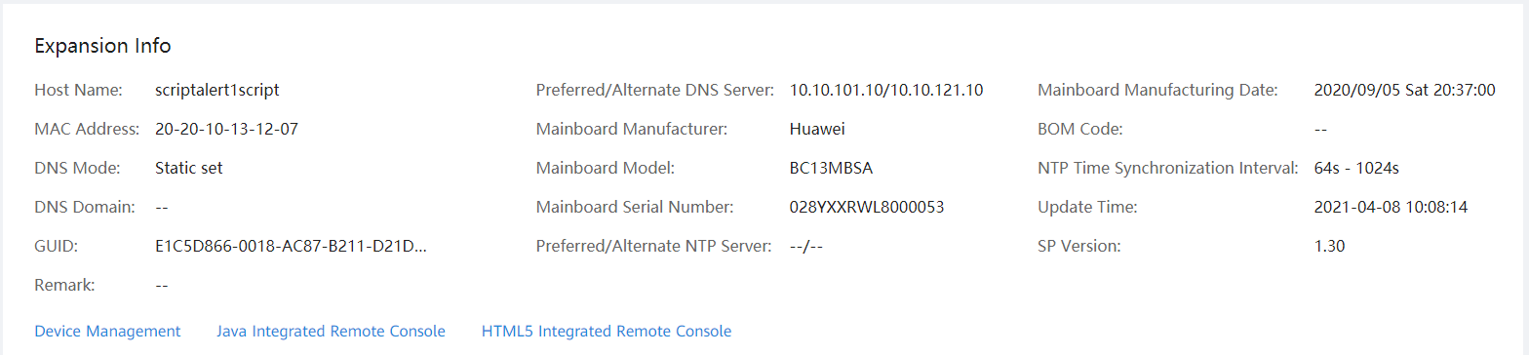
Resource Monitoring - Summary
Common operations
Device status
Device alarm information
Heath status statistics on present components
Extended information
Remote redirection to the BMC management page

Slide 17
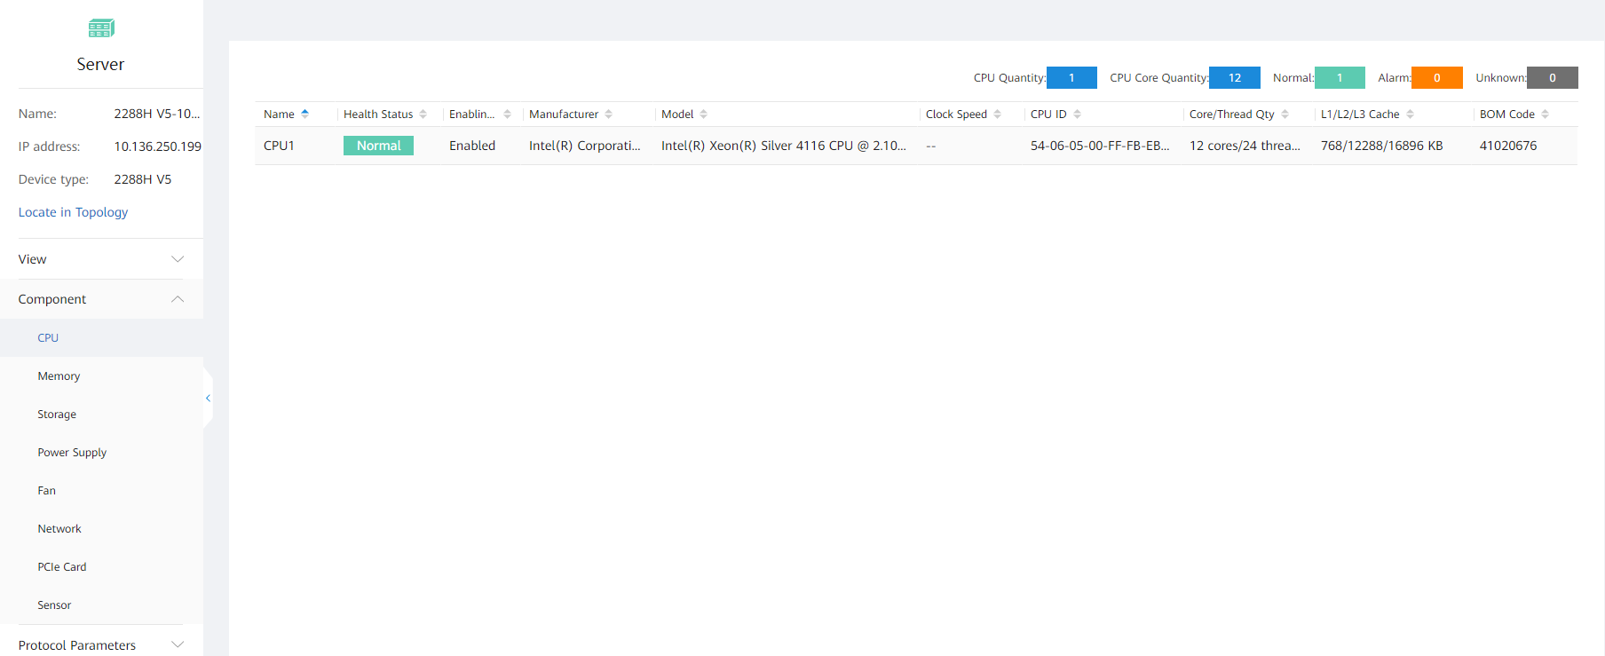
Resource Monitoring - Component Information
Displayed component details include the following information:
Processor information: name, health status, enabling status, vendor, model, dominant frequency, processor ID, number of cores/threads, L1/L2/L3 cache, part number, total number of CPUs, and total number of CPU cores
Memory information: name, health status, location, vendor, capacity, dominant frequency, serial number, type, minimum voltage, RANK (column), bit width, technology, part number, total number of memories, and total memory capacity
Power supply information: name, health status, vendor, model, firmware version, protocol, rated power, input mode, redundancy mode, and working mode
Fan information: name, health status, part number, and control mode
Network information: NIC name, health status, NIC location, NIC type, vendor, model, chip vendor, chip model, firmware version, driver name, and driver version
PCIe card: name, health status, slot number, type, vendor, description, and firmware version
Sensor: name, status, unit, upper threshold for critical alarms, lower threshold for critical alarms, upper threshold for major alarms, lower threshold for major alarms, upper threshold for minor alarms, and lower threshold for minor alarms

Slide 18
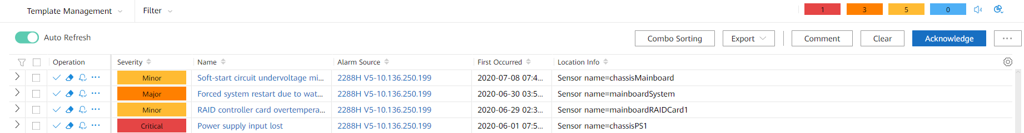
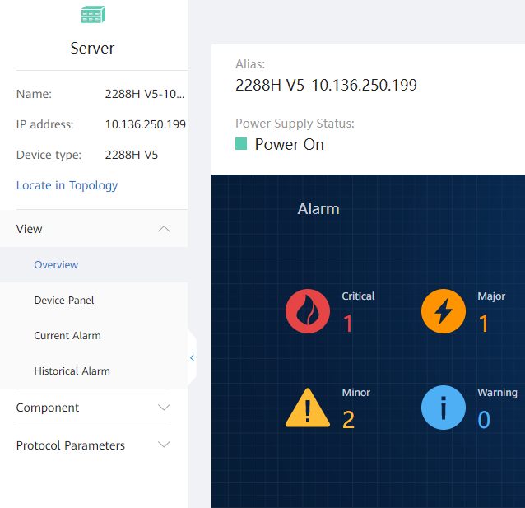
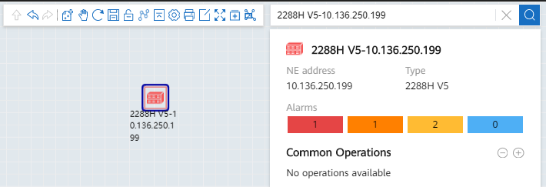
Alarm Management
Alarm monitoring homepage
Monitoring alarm statistics in the NE manager
Alarm statistics of devices in the topology

Slide 19
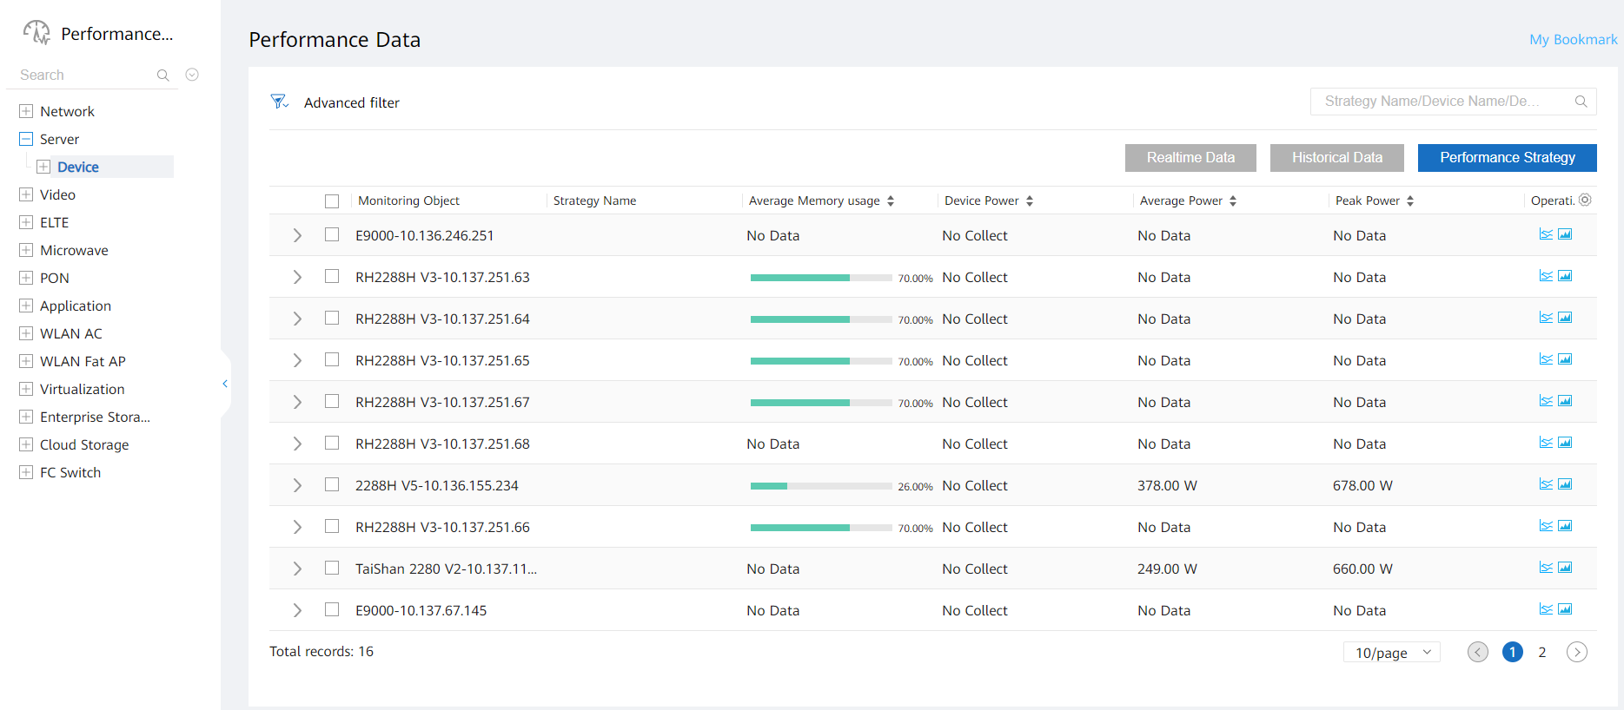
Performance Management
Displayed Real-time performance indicators include the following indicators:
Power, device CPU usage, intake temperature, heat, power consumption, disk usage, fan speed, device memory usage, and network bandwidth usage
For details about the server models and indicators supported by performance monitoring, see eSight 21.0 Server Management Performance Indicator List.

Slide 20
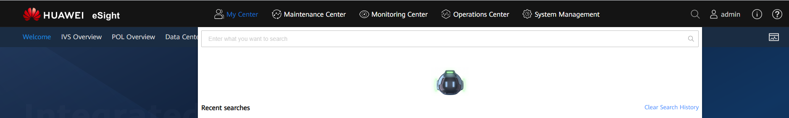
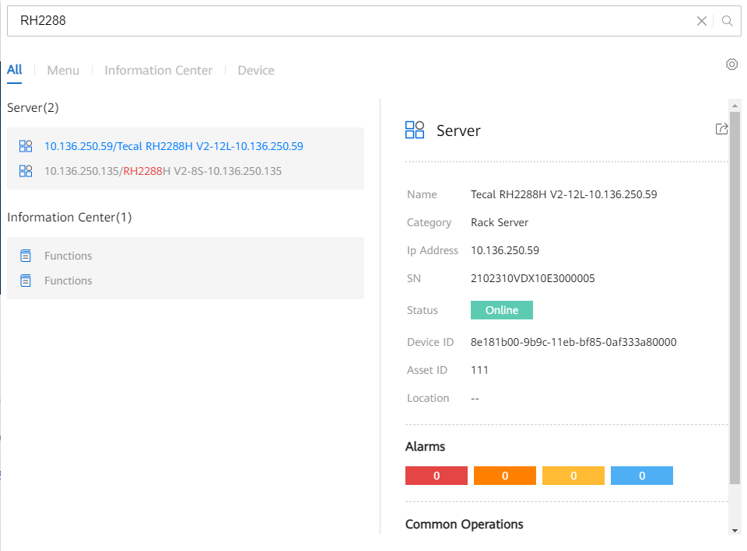
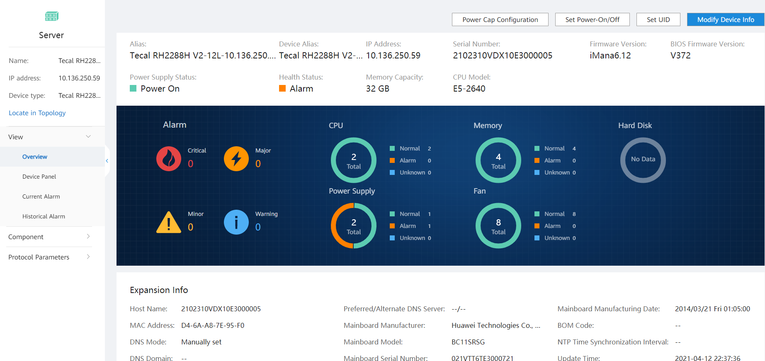
Global Search: Quickly Locating Resources to Improve O&M Efficiency
Convenient search entry. You can search for servers by server ID, name, IP address, SN, asset number, and location.
Global search entry, which is used to search for resources based on key attributes
Quickly locate the abnormal resources based on its key attributes and switch to the resource MOUI for 360° analysis.

Slide 21
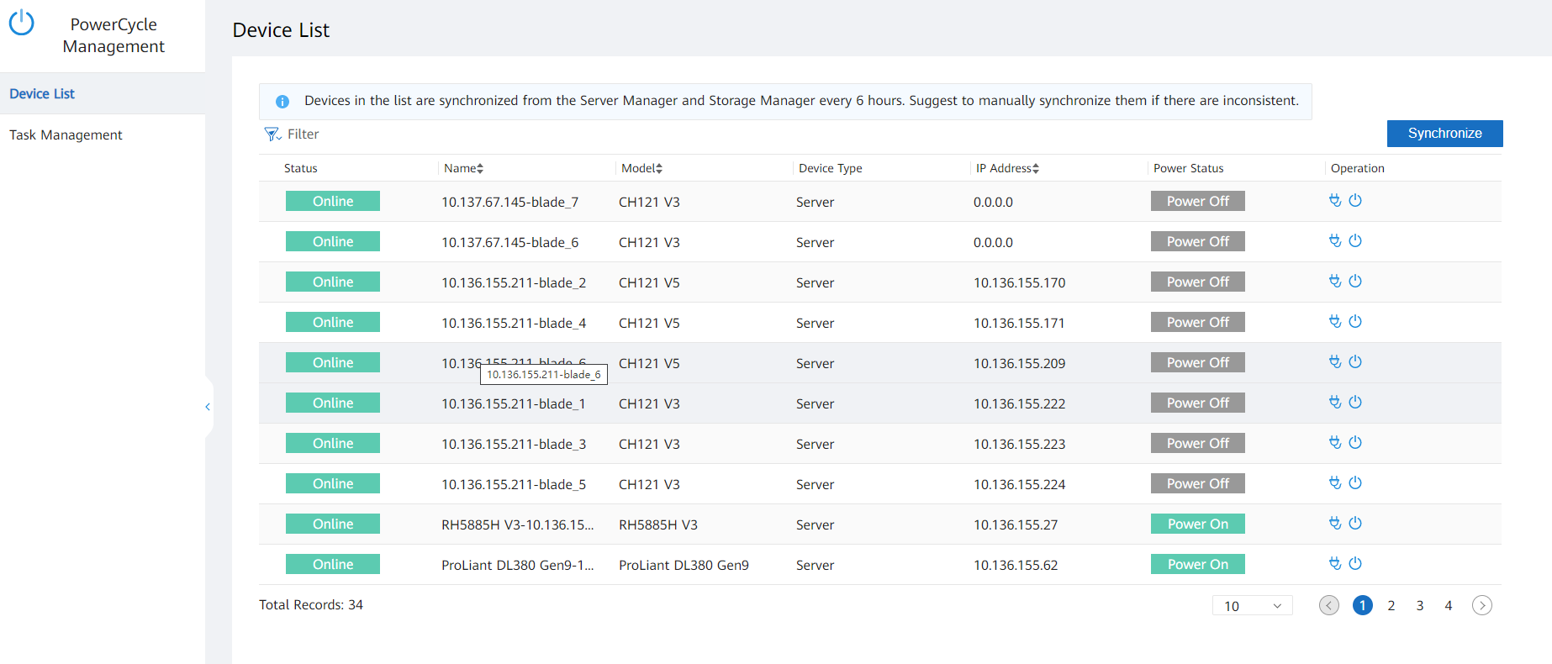

Power-On and Power-Off Management - Device List
After servers are connected to eSight, the servers that support power-on and power-off operations are automatically displayed in the device list, including the status, name, and power status of the servers. For details about the supported server models, see the server specification list.
If the number of servers supporting power-on and power-off operations is inconsistent with the number of storage servers, click Synchronize to perform device synchronization.
Powering on or off a single server

Slide 22
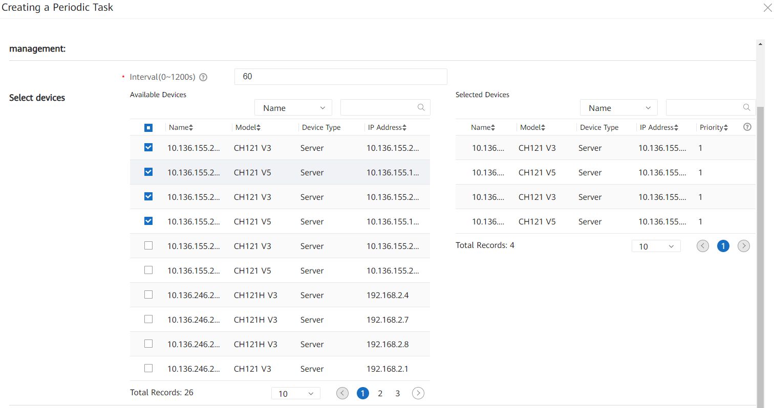
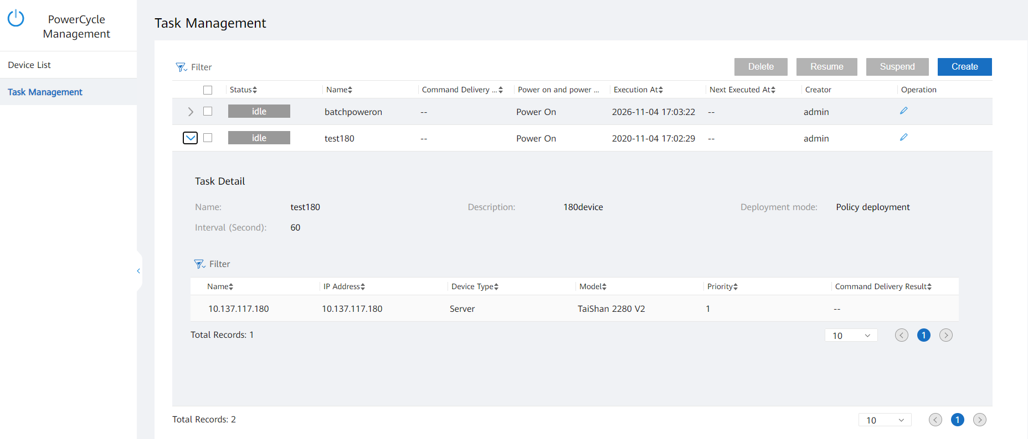
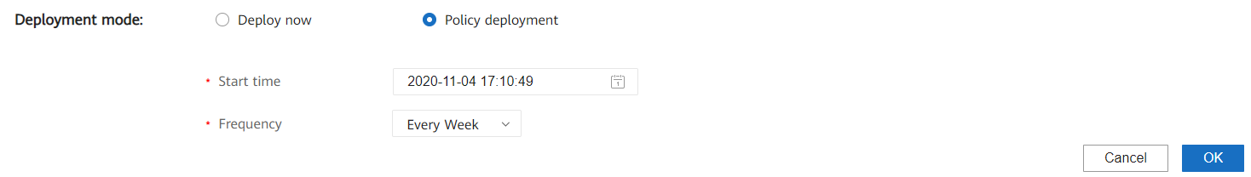
Power-On and Power-Off Management - Task Management
Task management
Interval at which commands are executed for devices with different priorities. The value ranges from 1 to 10, in descending order. Devices with higher priorities are powered on or off first.
Create a task to power on or off devices in batches.
Modify power-on and power-off tasks.
Delete, resume, and suspend tasks.
The start time can be set for a single, daily, monthly, or annual power-on or power-off task.
Constraints:
1. The real-time update of the server power-on and power-off status depends on device alarm reporting. Ensure that the device alarm reporting function is available. Otherwise, you need to click Synchronize on the Server Device Management page to obtain the latest power-on and power-off status.

